Slide 1
MY LIFE
Scary things

Slide 2
TAKING THIS WORLD WITH A SMILE😊😊😊😊
Well it all started on a dark night ,the wind howled which made bones shiver, being a Witcher who “as they say "is immune to fear or lacks human emotions, walking in this lonely forest as I searched for the illusive Gremlin

Slide 3
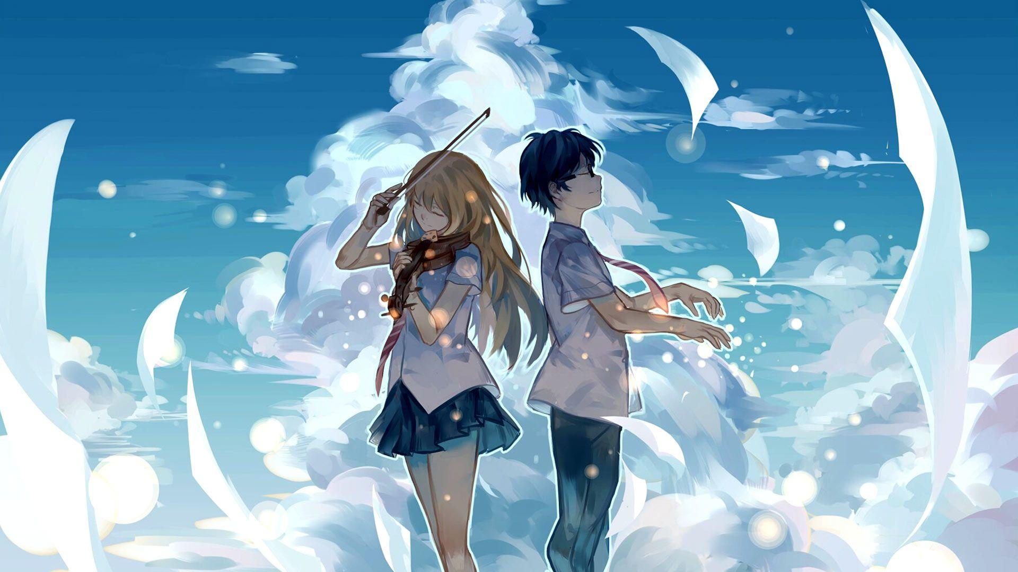
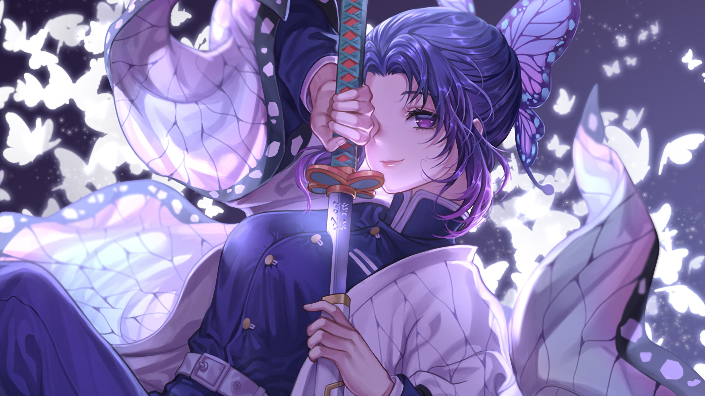
The Features of Gremlins
Male
Female

